Slide 1
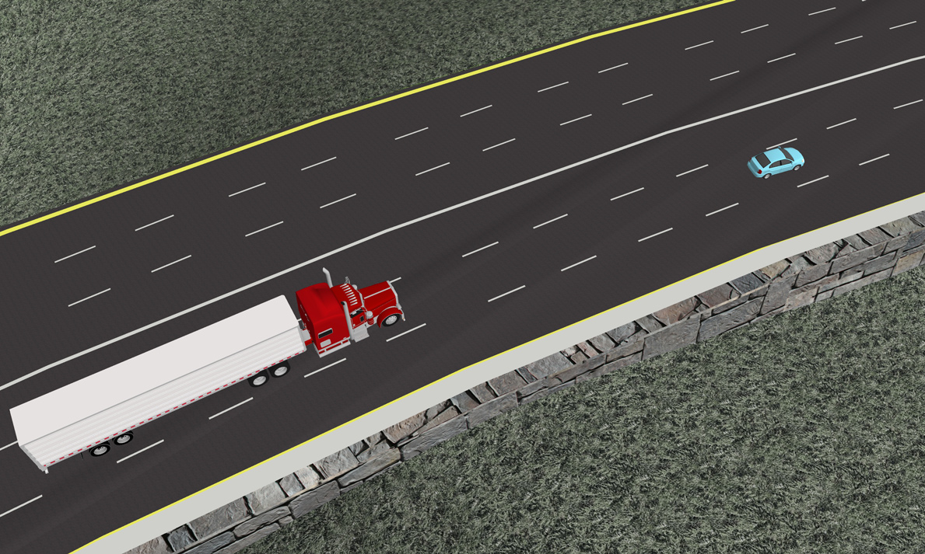
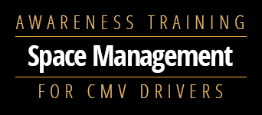


Slide 2
Safe Following Distances
1
What you need to know:
FMCSA recommendations for safe following distances
When to increase your following distance

Slide 3

Points to Remember
When driving behind other vehicles, leave 1 second of following distance for each 10 feet of your vehicle’s length.
At speeds above 40 mph, add an additional second to your following distance.
Increase your following distance by as much as twice the normal distance in adverse conditions, such as the following:
  Inclement weather
  Darkness
  Debris in the road
  Construction

Slide 4
No-Zones
2
What you need to know:
The location of your vehicle’s biggest blind spots (no-zones)
Scenarios where your blind spots may be the most dangerous

Slide 5









All Trucks have No Go zones. CMV Drivers need to be aware of the vehicles in the space. Try to adjust your speed so that these vehicles can safely go around you and not be in your blind spots.

Slide 6
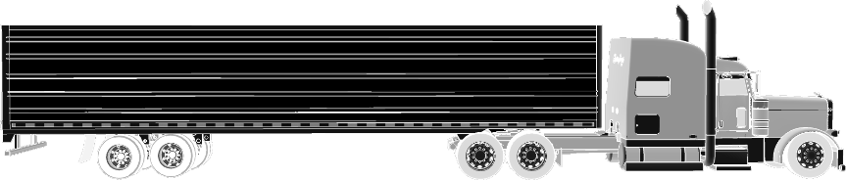

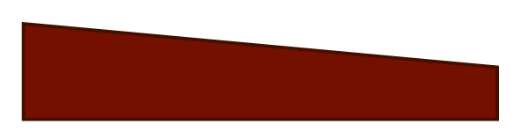
?
?
A typical CMV has a ________ foot blind spot directly in front of the vehicle and a ________ foot blind spot directly behind.
  5, 20
  10, 15
  20, 30
  40, 60
Notes:
Correct Answer is 20, 30.

Slide 7
Points to Remember
Most CMVs have no-zones (large blind spots) that other motorists may not be aware of.
Your vehicle’s blind spots can make seemingly simple tasks, such as changing lanes, making turns, or backing up more challenging and dangerous.

Slide 8
Managing Your Space
3
What you need to know:
Defensive driving principles
Best practices for driving in intersections, safe backing, and managing vertical clearances

Slide 9
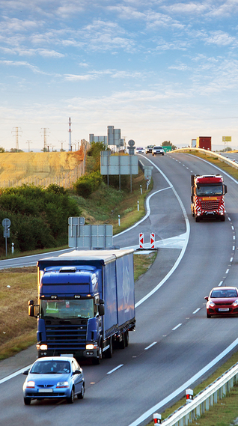
Defensive Driving
3 Managing Your Space
Practicing basic defensive driving habits at all times will help you to stay safe and aware of other vehicles and potential obstacles in the road.
Defensive driving habits:
Keep your distance from other vehicles.
Make sure your speed is appropriate for the conditions.
Always leave yourself an escape route.
Check all of your mirrors at regular, frequent intervals (every 5 – 8 seconds), as well as before changing lanes, turning, or merging.
Stay alert for changes in the road or driving conditions ahead:
  On highways, look approximately ¼ mile ahead.
  When passing through cities or towns, look approximately 1½ blocks ahead.

Slide 10
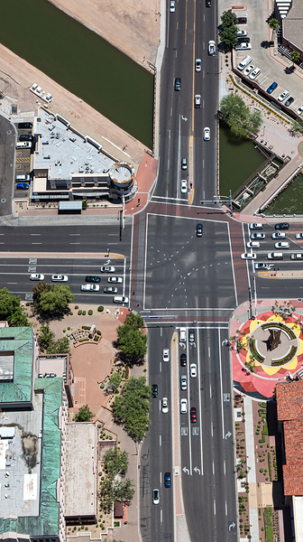
Intersections
3 Managing Your Space
Approach and enter intersections with caution.
Before entering an intersection, double-check in each direction of crossing traffic to make sure that your path is clear.
Safe turning guidelines:
When turning—especially when making right-hand turns—use extra caution to assure that the blind spots on the side of your vehicle facing the turn are clear.
Use your turn signals well in advance—at least 100 feet and up to 500 feet in heavy traffic.
Check your mirrors often throughout the entire turning procedure.
Maneuver your truck in such a way that blocks other vehicles from attempting to “sneak by” while you’re attempting a right turn.

Slide 11
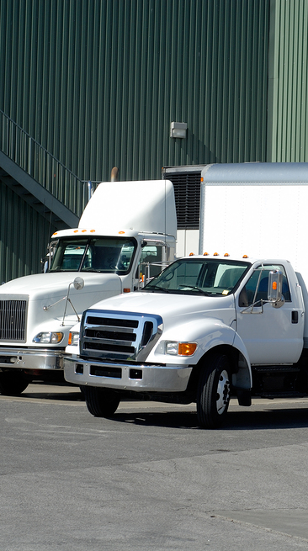
Backing Safely
3 Managing Your Space
Remember these best practices whenever performing backing operations:
Avoid backing whenever possible.
Park your truck in such a way that you can pull forward when leaving.
Back towards the driver's side whenever possible for maximum visibility.
Turn your hazard lights on before beginning the operation, and leave them on until you are parked.
Make sure you are fully aware of your surroundings before beginning to back up.
  Walk around your vehicle to make sure your path is clear.
  Frequently check all mirrors.
  Recruit a spotter when possible, but be aware that you are the one responsible if you back into something.
  Always remember, when in doubt, get out and look.

Slide 12
Backing Safely (continued)
3 Managing Your Space
Remember these best practices whenever performing backing operations:
Do not use the throttle when backing up; only use idle speed.
Be patient and give yourself the time to safely maneuver around obstacles.
Give the backing operation your full attention; turn off your radio, phone, music, or any other potential distractions before beginning the operation.

Slide 13
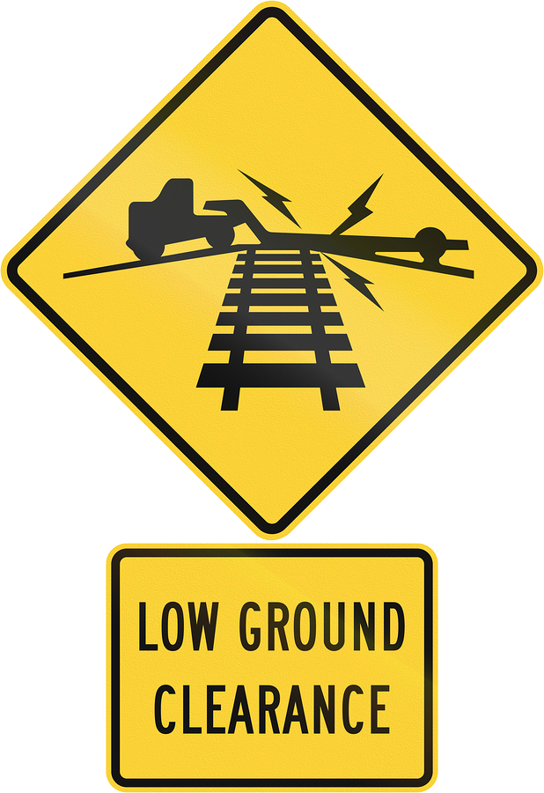
Ground Clearance
3 Managing Your Space
Pay extra attention to ground clearance when approaching uneven terrain, such as railroad crossings, damaged or potholed roads, or ramps at curbs or loading docks.
Adequate ground clearance is especially vital when hauling loads with low clearance (e.g., lowboy or car carrier trailers).

Slide 14
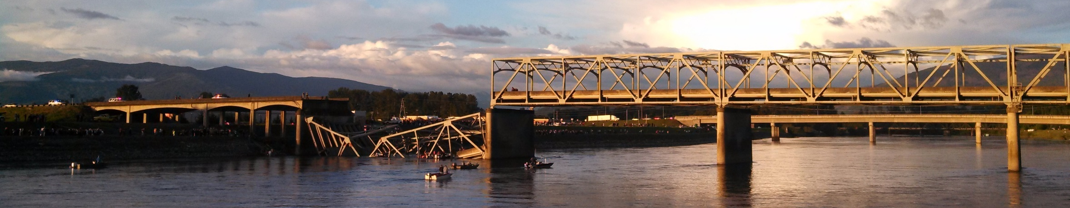
Vertical Clearance: The Skagit River Bridge Incident
Image by Martha T, Wikimedia Commons
MOUNT VERNON, Wash. (May 23, 2013)—A portion of the I-5 Skagit River Bridge collapsed after a semi-trailer truck carrying an oversize load struck one of the bridge’s overhead struts. The truck’s load was over a foot taller than the maximum overhead clearance for the lane in which the truck was traveling.
Other lanes over the bridge would have allowed the truck to cross without incident, but the outer lane’s clearance
was not posted in advance of the bridge and the truck’s pilot car never signaled to the driver that the bridge would pose an issue.
While no one was seriously hurt in the collapse, a Washington State Trooper was killed while directing traffic through the detour and traffic had to be rerouted for nearly a month while a replacement span was installed.
Total cost of accident: $19,844,383

Slide 15
Vertical Clearance: Your Responsibility
Image by Martha T, Wikimedia Commons
You are always responsible for making sure that your vehicle will clear overhead obstacles, even when working with a pilot vehicle.
Always verify your load’s height, whether it is oversized or a standard trailer.
Before beginning a trip, check your route for any potential overhead obstacles, such as low overpasses, tunnels, signage, or power lines.
Laws for posting signage on or ahead of low overpasses vary from state to state; know the applicable laws for the states you pass through on your trip.
If you are uncertain whether or not your vehicle will clear an object, adjust your route to avoid it rather than taking the risk.

Slide 16
Summary
Finish
The FMCSA recommends maintaining a following distance of 1 second per 10 feet of your vehicle’s length.
The ideal safe following distance varies depending on your vehicle’s size and weight, your speed, and the road conditions.
Most CMVs have no-zones (large blind spots), which other motorists may not be aware of.
Your vehicle’s no-zones can make seemingly simple tasks, such as changing lanes, making turns, or backing up more challenging and dangerous.
You can effectively manage the space around your vehicle by:
  Practicing basic defensive driving habits.
  Staying alert of conditions up the road.
  Regularly checking your mirrors.
  Taking extra caution when approaching intersections.

